Slide 1
Team M
Clifford Kaunang, Gee Li, Gustin Lowe, Kino Jiang, and Nhi Hoang

Slide 2
Individual Roles

Slide 3
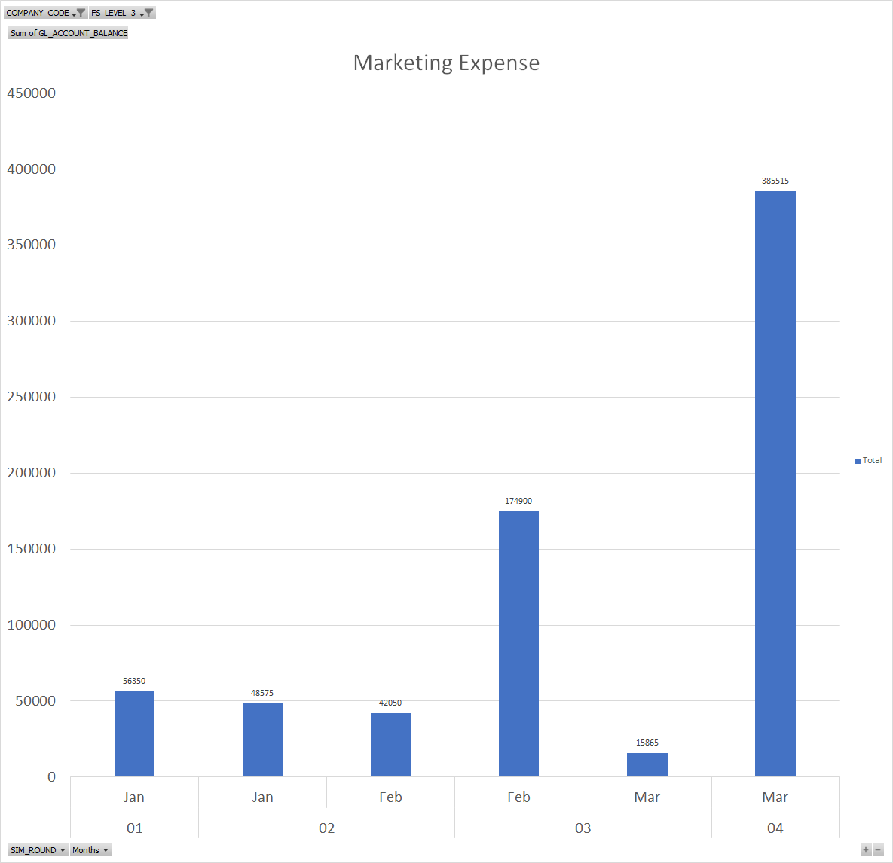
Clifford Kaunang
Role: Marketing Manager
Responsibilities
Determining when we should advertise an item
Appropriating funds to advertise certain items
Regulating the amount spent in each area (North, South, and West)
Primary Reports Used: Operational (Financial Statements) and Informational Reports (Sales Report)
Cash-to-cash Cycle: Determining appropriate times to spend on marketing

Slide 4
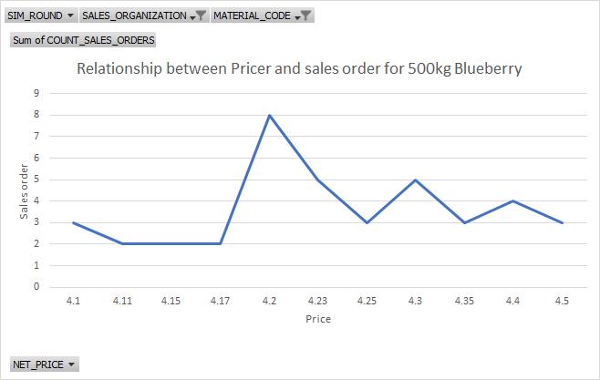
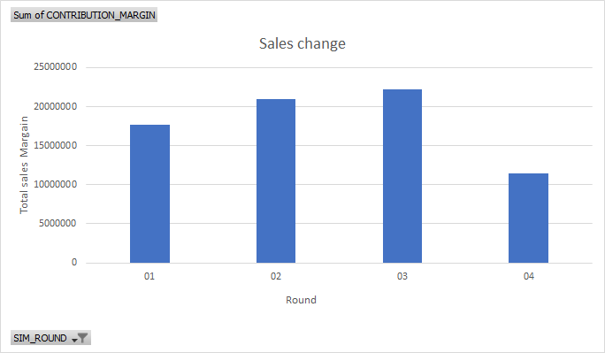
Kino Jiang
Role: Price Manager
Responsibilities:
Adjust Price for increasing the sales
Based on sales, distribution and inventory status
Primary Report Used：
Detailed Sales Report
Summary Sales Report
Inventory Report
Cash-to-cash Cycle: Sales

Slide 5
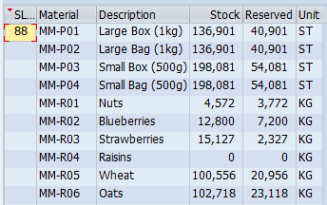
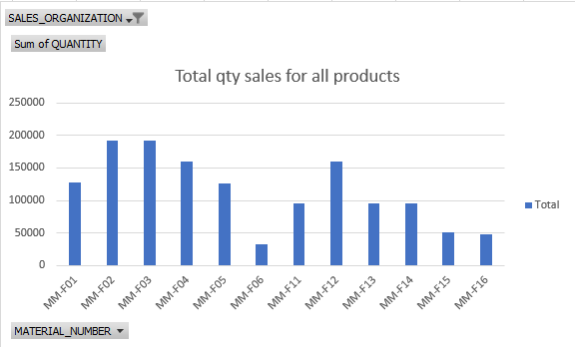
Gee Li
Role: Procurement Manager
Responsibility:
Monitor raw material inventory
Create purchase order
Run the MRP run
Notify production manager ETD of the raw material
Primary report used:
Inventory report
Sales report
Cash-to-Cash cycle:
Cost of purchase do not exceed revenue

Slide 6
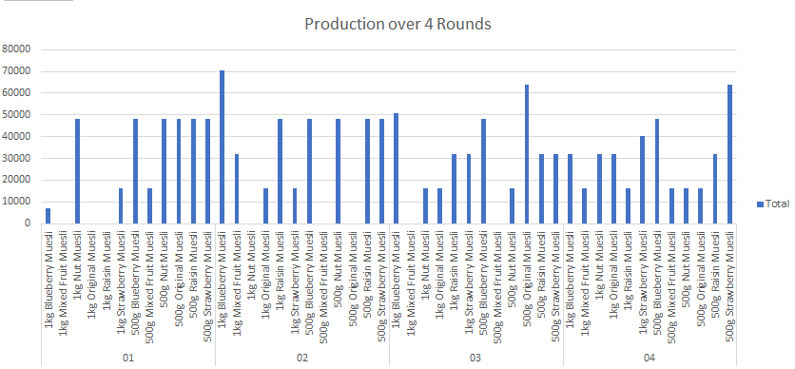
Nhi Hoang
Role: Production Manager
Responsibilities
Convert raw materials Finished goods
Produce finished goods on time before selling out
Ensure productivity: capacity & setup time
Primary Reports Used: Sales Report Inventory Report Production Schedule Report
Cash-to-cash Cycle: Indirectly affect sales

Slide 7
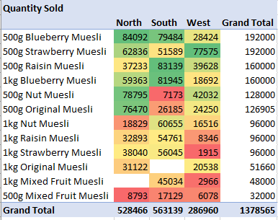
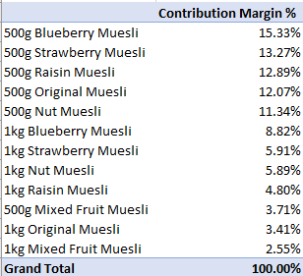
Gustin Lowe
Role: Material Planning & Sales Manager
Responsibilities:
Generate sales forecast
Organize operations plan
Communicate sales performance and inventory to other managers
Primary Reports Used:
Detailed Sales Report
Inventory Report
Cash-to-cash cycle: Material Planning , Sales

Slide 8
Team Response

Slide 9

Team Dynamics – organizational structure and separation of duties
Initial decisions were made based upon feedback from the practice
During rounds, decision we made based on new information generated
Established lines of communications
Responsibilities divided amongst group based on comfortability and overall familiarity with the action.
Enabled vs Restricted
Enabled - Segregate transactions into individual responsibilities
Restrictions - Simultaneous access into some transactions

Slide 10
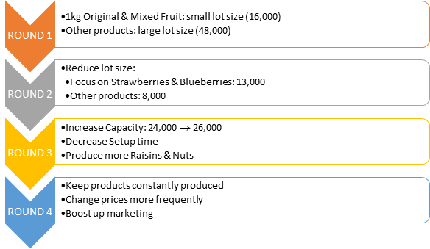
Business Strategy – strategic decision points throughout the process

Slide 11
Process Execution
Approach:
Procurement: order when inventory below safety stock level
Production: produce best selling products only
Sales: different prices for different distribution channels
How the approach changed?
Procurement: increase qty available to order in planning
Production: produce other products if not enough raw material to produce best selling products
Sales: decrease price or increase marketing expenses when products are not selling
Executing efficiency:
Low - ordered huge amount of raw material but not enough time to convert into production.
SAP role in the simulation:
Restricted - “Excel in Place” view took too long to process

Slide 12
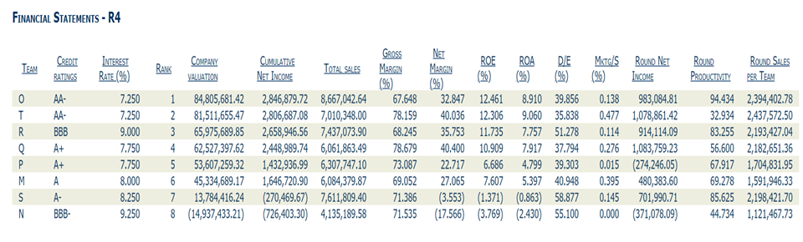
Data Analytics

Slide 13
Results
Results : Middle Level
Decision :
Positive:
Increasing Capacity
Reducing setting time
Communicate Strategy
Negative:
Poor initial strategy
Be too cautious of investment
Change price too frequently in last round
What Can we do
Implement our good decision from first round
Invest in capacity and setting time
Focus on best - selling food
Change price strategy
Predicate the most suitable price range

Slide 14
Thank you

